Slide 1
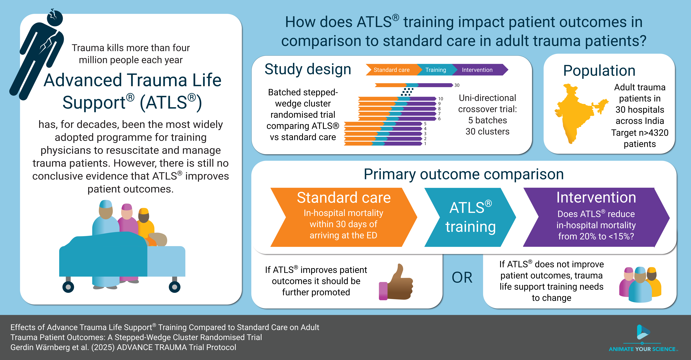

Slide 2

ADVANCE TRAUMA
Effects of Advanced Trauma Life Support® Training Compared to Standard Care on Adult Trauma Patient Outcomes: A Stepped-Wedge Cluster Randomised Trial
Protocol Summary

Slide 3


Slide 4

Trauma Scope of the problem
>4
million deaths globally
~2
million quality-related deaths in LMIC
#1
cause of disease burden in people aged 10-49 years
$4.2
trillions in the US alone

Slide 5
ATLS Purpose and content
“emphasizes the rapid initial assessment and primary treatment of injured patients, starting at the time of injury and continuing through initial assessment, lifesaving intervention, reevaluation, stabilization, and, when needed, transfer to a trauma center”
> ATLS® Student Course Manual. 10th ed. 2018.

Slide 6

ATLS Spread and dissemination
1978
first course
>80
countries worldwide
>1
million physicians trained

Slide 7
ATLS Impact on providers’ knowledge and skills
“There is abundant evidence that ATLS training improves the knowledge base, the psychomotor skills and their use in resuscitation, and the confidence and performance of doctors who have taken part in the program. The organization and procedural skills taught in the course are retained by course participants for at least 6 years, which may be the most significant impact of all”
> ATLS® Student Course Manual. 10th ed. 2018.

Slide 8
ATLS Evidence of impact on providers’ knowledge and skills
Three randomised controlled studies:
Ali J et al. 1995: “Using highly reliable trauma OSCE stations we have demonstrated trauma management skills acquisition by senior medical students after the ATLS course.”
Ali J et al. 1996: “… improvement in OSCE scores, adherence to trauma priorities, maintenance of an organized approach to trauma care, and cognitive performance in MCQ examinations.”
Ali J et al. 1999: “Using standard ATLS pass criteria, performance after the new and old ATLS courses was similar.”

Slide 9
ATLS Impact on patient outcomes
“ATLS training in a developing country has resulted in a decrease in injury mortality. Lower per capita rates of deaths from injuries are observed in areas where providers have ATLS training. In one study, a small trauma team led by a doctor with ATLS experience had equivalent patient survival when compared with a larger team with more doctors in an urban setting. In addition, there were more unexpected survivors than fatalities”
> ATLS® Student Course Manual. 10th ed. 2018.

Slide 10
ATLS Evidence of impact on patient outcomes
Four systematic reviews:
Mohammad A et al. 2013: “Future studies are required to properly evaluate the impact of ATLS training on trauma death rates and disability.”
Jayaraman S et al. 2014: “There is no evidence from controlled trials that ATLS or similar programs impact the outcome for victims of injury.”
Jin J et al. 2021: “In-hospital trauma training with certified courses resulted in a reduction of mortality (RR 0.71, 95% CI 0.62 to 0.78).”
Putra AB et al. 2023: “ATLS had no significant effect in reducing the risk of mortality (OR: 0.68; 95% CI 0.39 – 1.20; p = 0.18).”

Slide 11
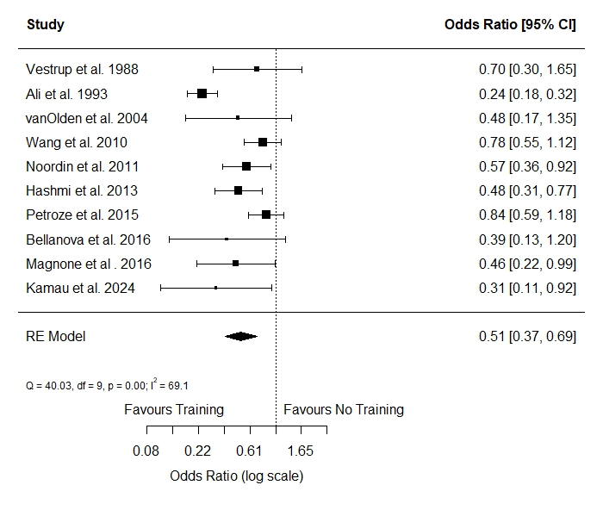
ATLS Evidence of impact on patient outcomes
Updated systematic review:
search in August 2025;
screened 9,656 records;
included 10 observational studies; and
estimated a pooled odds ratio of 0.51.

Slide 12
ATLS Critique
Costly
Perpetuate theories despite evidence of the contrary
Not adapted to modern trauma care
Not adaptable to local circumstances
Fixed didactic nature

Slide 13
Aim To compare the effects of ATLS® training with standard care on outcomes in adult trauma patients

Slide 14
Design Key aspects and justification
Study design
Batched stepped-wedge cluster randomised trial:
30 hospitals
6 batches
5 sequences
13 months in trial
Justification
Is conducted in India because:
Ongoing collaborations > 10 years
ATLS training not yet standard

Slide 15
Design Cluster randomised designs
A. Parallel design
1 | Intervention
2
3 | Control
4
 | 1 | 2 | 3 | 4 | 5 | 6 | 7 | 8 | 9 | 10
B. Parallel design with before and after
1 | Control |  |  |  |  | Intervention
2
3
4
 | 1 | 2 | 3 | 4 | 5 | 6 | 7 | 8 | 9 | 10
C. Stepped-wedge design
1 | Control |  | Intervention
2
3
4
 | 1 | 2 | 3 | 4 | 5 | 6 | 7 | 8 | 9 | 10
D. Batched stepped-wedge design
1 | Control |  | Intervention
2
3
4
 | 1 | 2 | 3 | 4 | 5 | 6 | 7 | 8 | 9 | 10
Cluster
Time

Slide 16
Design Cluster randomised designs
A. Parallel design
1 | Intervention
2
3 | Control
4
 | 1 | 2 | 3 | 4 | 5 | 6 | 7 | 8 | 9 | 10
B. Parallel design with before and after
1 | Control |  |  |  |  | Intervention
2
3
4
 | 1 | 2 | 3 | 4 | 5 | 6 | 7 | 8 | 9 | 10
C. Stepped-wedge design
1 | Control |  | Intervention
2
3
4
 | 1 | 2 | 3 | 4 | 5 | 6 | 7 | 8 | 9 | 10
D. Batched stepped-wedge design
1 | Control |  | Intervention
2
3
4
 | 1 | 2 | 3 | 4 | 5 | 6 | 7 | 8 | 9 | 10
Cluster
Time

Slide 17
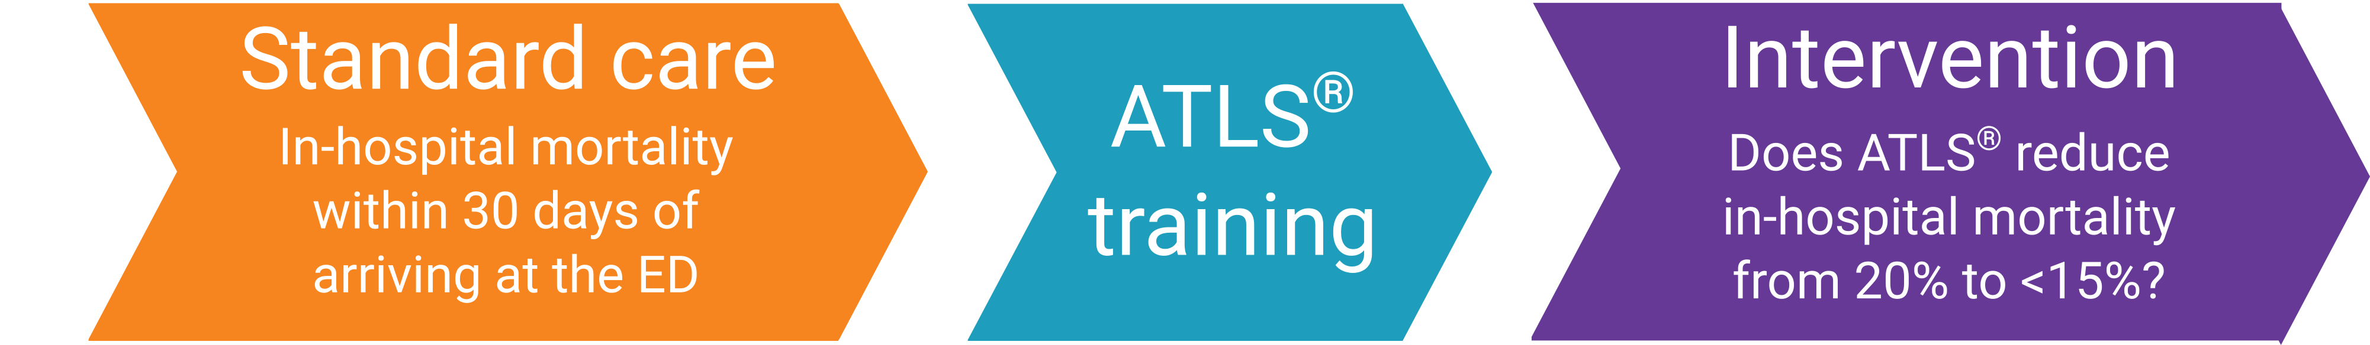
Primary outcome
30-day in-hospital mortality
Collected through medical records for patients admitted or discharged home
Collected through telephonic follow-up for patients transferred to another hospital

Slide 18
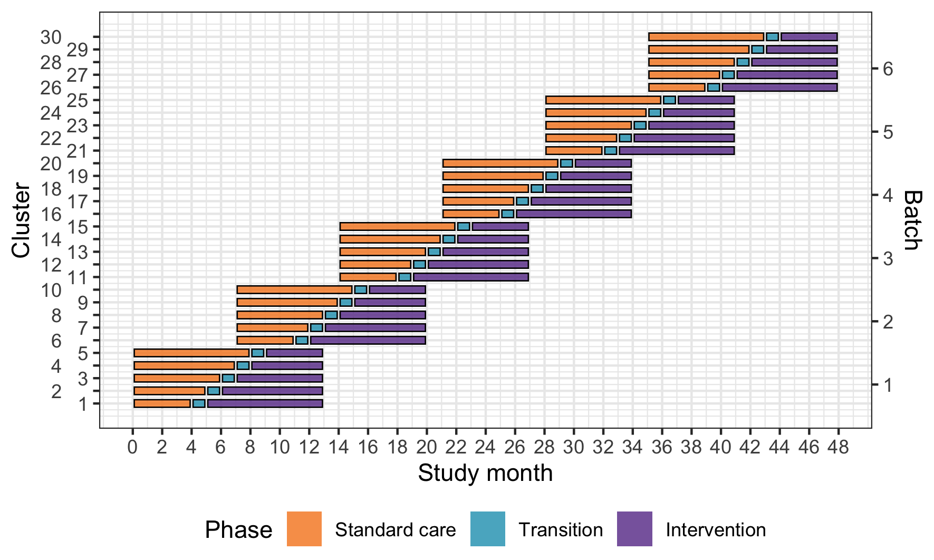
Main Design

Slide 19
Secondary outcomes
All patients using main stepped-wedge design:
All cause and in-hospital mortality at 24 hours, 30 days and 90 days
Length of stay, in the ED, ICU and hospital
Return to work, measured at 30 days and 90 days
Random subset of patients using nested staircase design
Adherence to ATLS principles, collected through observations
Quality of life, measured using EQ5D5L at 30 days and 90 days
Disability, measured using WHODAS 2.0 at 30 days and 90 days

Slide 20
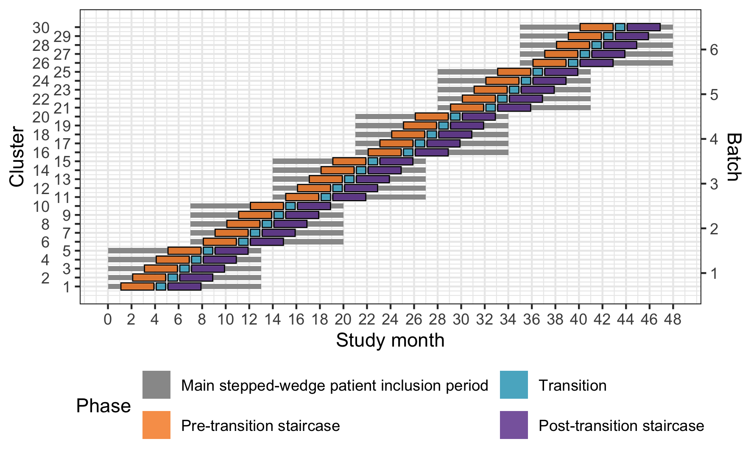
Nested staircase design

Slide 21
Eligibility criteria
Cluster
One or more units of physicians providing initial trauma care in the secondary or tertiary hospitals that admit or refer/transfer for admission at least 400 patients with trauma per year
Patient
Adult trauma patients presenting to the emergency department of participating hospitals and who are admitted

Slide 22
Intervention and control ATLS and standard care
Control
Standard care varies across hospitals in India
Trauma patients are initially managed by 1st or 2nd year resident
No formal trauma life support training
Intervention
2.5 day ATLS training course
Accredited ATLS training facility in India
1-2 units per hospital

Slide 23
Sample size Effect size, clusters and patients
Detect a reduction in 30-day in-hospital mortality from 20 to 15% with 90% power
30 clusters
At least 4320 patients
Requires at 12 patients per cluster and period (month)

Slide 24









Trial organisation Main applicants
Martin Gerdin Wärnberg
Ass. Professor
Karla Hemming
Professor
Nobhojit Roy
Lead, Program for
Global Surgery &
Trauma
Lisa Strömmer
Ass. Professor
Li Felländer-Tsai
Professor
Vivekanand Jha
Executive Director,
Professor

Slide 25
Current Status Progress and funding
First batch ongoing since February 2025
~900 included patients
Second batch will start in December
Expect to continue until December 2028, pending more funding

Slide 26


Implications
If ATLS improves patient outcomes it should be further promoted
If it does not, then trauma life support training needs to change

Slide 27
ADVANCE TRAUMA
Effects of Advanced Trauma Life Support® Training Compared to Standard Care on Adult Trauma Patient Outcomes: A Stepped-Wedge Cluster Randomised Trial
Protocol Summary

